Slide 1
Today’s Topic
Function
Slides for CS 31 discussion session
TA: Hsiao-Yun (Katie) Tseng tsenghy@g.ucla.edu
Credit to former TA Bo-Jhang Ho (bojhang@cs.ucla.edu), CS31 Discussion 1E, Spring 17’
Credit to former TA Chelsea Ju (chelsea.ju@cs.ucla.edu)

Slide 2
What is a function
int
double
string
double
Take some numbers, produce a result value

Slide 3
What is a function
f(x) = 2x + 3
What is f(5)?

Slide 4
What is a function
f(x, y) = 3x + 2y - xy
What is f(4, 1)?

Slide 5
What is a function
int square(int n) { return n * n; } int main() { int a = 3; int b = 6; a = a * b + square(a + b); cout << a << endl; return 0; }
What is the output?

Slide 6
What is a function
int square(int n); int main() { int a = 3; int b = 6; a = a * b + square(a + b); cout << a << endl; return 0; } int square(int n) { return n * n; }
When a function is called, it always look back and try to find the function.
If you want to declare it before the callee, you have to declare it first.

Slide 7
Quiz time
11 questions on the website

Slide 8
Why function?
Save repeating codes
Make the main function more compact

Slide 9
Function
Can we write a function which exchange the values of two variables?
void swap(int x, int y) { //TODO: how to do this? } int main() { int a = 3; int b = 6; swap(a, b); // Hope a = 5, b = 3 now return 0; }

Slide 10
Reference
We can use reference (& after the data type) to achieve the task
void swap(int &x, int &y) { int t = x; x = y; y = t; } int main() { int a = 3; int b = 6; swap(a, b); cout << "a=" << a << ", b=" << b << endl; // Hope a = 5, b = 3 now return 0; }
x, y are going to control a, b

Slide 11
Have you done the exercise?
* ** *** **** *****
* ** *** **** *****
Done!
***** **** *** ** *
***** **** *** ** *

Slide 12
New challenges!
* *** ***** *** ***** ******* ***** ******* ********* *********** ********* *********** ************* *** ***
* *** ***** ******* ********* *********** *************

Slide 13
Draw a shape
Observation: For each line, we always print some white spaces, and then some stars, and an endline character.
* *** ***** *** ***** ******* ***** ******* ********* *********** ********* *********** ************* *** ***
* *** ***** ******* ********* *********** *************

Slide 14
Draw a shape
Observation: For each line, we always print some white spaces, and then some stars, and an endline character.
void printSpaceStarLine(int numSpaces, int numStars) { for (int i = 0; i < numSpaces; i++) cout << " "; for (int i = 0; i < numStars; i++) cout << "*"; cout << endl; }

Slide 15
Draw the pyramid
void printSpaceStarLine(int numSpaces, int numStars) { for (int i = 0; i < numSpaces; i++) cout << " "; for (int i = 0; i < numStars; i++) cout << "*"; cout << endl; } int main() { printSpaceStarLine(6, 1); // * printSpaceStarLine(5, 3); // *** printSpaceStarLine(4, 5); // ***** printSpaceStarLine(3, 7); // ******* printSpaceStarLine(2, 9); // ********* printSpaceStarLine(1, 11); // *********** printSpaceStarLine(0, 13); //************* return 0; }

Slide 16
Draw the pyramid
void printSpaceStarLine(int numSpaces, int numStars) { for (int i = 0; i < numSpaces; i++) cout << " "; for (int i = 0; i < numStars; i++) cout << "*"; cout << endl; } int main() { int size = 7; for (int i = 0; i < size; i++) printSpaceStarLine(size - 1 - i, 2 * i + 1); return 0; }

Slide 17
Draw the X’mas tree
void printSpaceStarLine(int numSpaces, int numStars); int main() { printSpaceStarLine(5, 1); // * printSpaceStarLine(4, 3); // *** printSpaceStarLine(3, 5); // ***** printSpaceStarLine(4, 3); // *** printSpaceStarLine(3, 5); // ***** printSpaceStarLine(2, 7); // ******* printSpaceStarLine(3, 5); // ***** printSpaceStarLine(2, 7); // ******* printSpaceStarLine(1, 9); // ********* printSpaceStarLine(2, 7); // ******* printSpaceStarLine(1, 9); // ********* printSpaceStarLine(0, 11); //*********** printSpaceStarLine(4, 3); // *** printSpaceStarLine(4, 3); // *** return 0; }

Slide 18
Draw the X’mas tree
void printSpaceStarLine(int numSpaces, int numStars); void printLayer(int startNumSpaces, int startNumStars) { printSpaceStarLine(startNumSpaces, startNumStars); printSpaceStarLine(startNumSpaces - 1, startNumStars + 2); printSpaceStarLine(startNumSpaces - 2, startNumStars + 4); } int main() { printLayer(5, 1); // * // *** // ***** printLayer(4, 3); // *** // ***** // ******* printLayer(3, 5); // ***** // ******* // ********* printLayer(2, 7); // ******* // ********* //*********** printSpaceStarLine(4, 3); // *** printSpaceStarLine(4, 3); // *** return 0; }

Slide 19
Draw the X’mas tree
void printSpaceStarLine(int numSpaces, int numStars); void printLayer(int startNumSpaces, int startNumStars) { printSpaceStarLine(startNumSpaces, startNumStars); printSpaceStarLine(startNumSpaces - 1, startNumStars + 2); printSpaceStarLine(startNumSpaces - 2, startNumStars + 4); } int main() { int size = 4; for (int i = 0; i < 4; i++) printLayer(size + 1 - i, 2 * i + 1); printSpaceStarLine(size, 3); printSpaceStarLine(size, 3); return 0; }

Slide 20
ASCII Characters
#include <cctype>
Some functions in this library:
int isalnum(int c); // alphanumeric
int isdigit(int c); // decimal digit
int islower(int c); // lowercase letter
int isupper(int c); // uppercase letter
int isspace(int c); // white-space
int toupper(int c); // convert to uppercase
int tolower(int c); // convert to lowercase
Don’t memorize them!

Slide 21
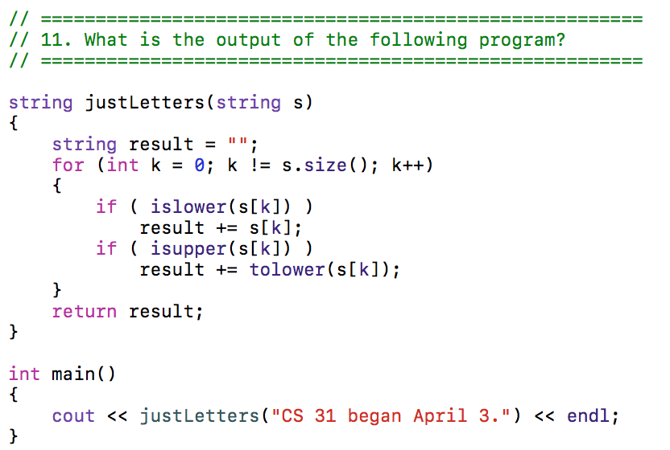
#include <cctype> example

